Slide 1

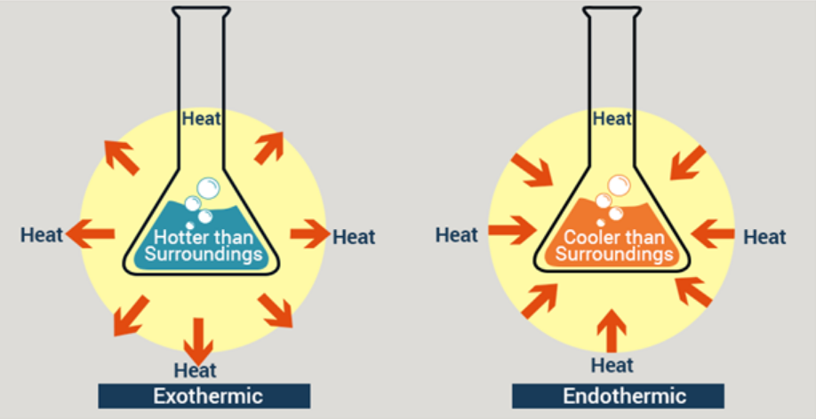
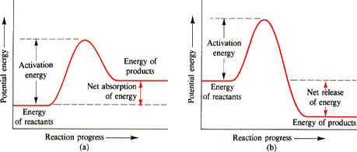
Review: Thermochemistry
Energy changes in chemical reactions
ATAR Chemistry Unit 3 2021

Slide 2
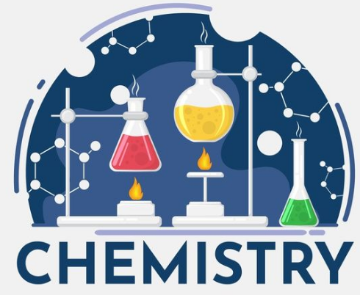
Outline
Review of thermochemistry
Resources:
Essential Chemistry (Unit 3 and 4) ch 1.1 to 1.3 and Set 1 Q1-4
STAWA 12 Set 4 – Reaction rates and energy (to be done after the review of reaction rates)
Your year 11 notes and resources

Slide 3
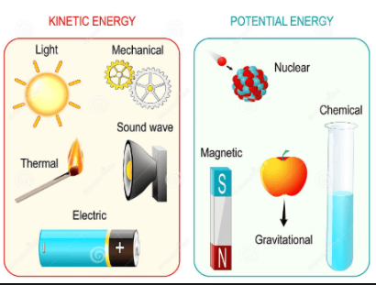
Energy
Energy is the capacity to do work or cause change
It is measured in joules (J)
Some forms of energy: heat energy, electrical energy, light energy, kinetic & potential energy and chemical potential energy
Energy is interchangeable, however the total amount of energy is always constant. Whenever one form of energy disappears or reduces in quantity, this results in an increase or appearance of another form
Law of conservation of energy

Slide 4
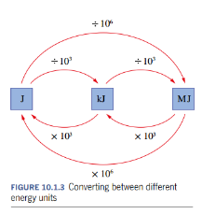
Energy
Standard units for energy
Standard units if joule, J
But we also use kilojoules, kJ and megajoules, MJ
1 MJ = 1000 kJ = 1 000 000 J
We cannot see bonds breaking and forming, but we can indirectly observe the energy change to looking at the effect the change has e.g. change of temperature, our bodies functioning
Ref: Pearson Year 11 Chemistry, WA edition.

Slide 5
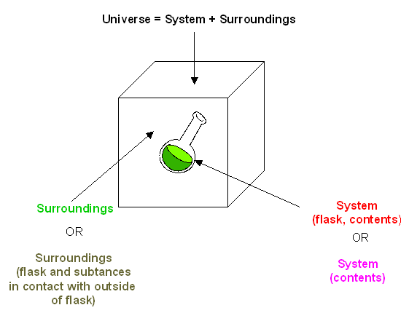
Energy
Law of conservation of energy: energy cannot be created or destroyed. However, it can change form
If the energy in a substance is reduced the excess must go somewhere…
If the substance needs more energy the energy must come from somewhere…
When we discuss energy changes, we refer to a system and its surroundings.
Energy in universe is constant

Slide 6

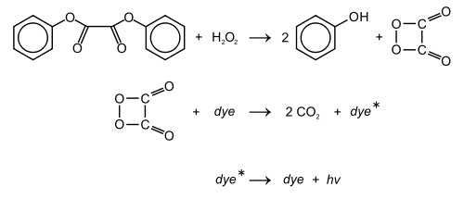
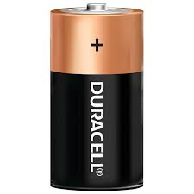
Energy in chemical reactions
In a chemical reaction energy is either absorbed or release from the system to the surroundings typically in the form of thermal (heat) energy
However, chemical potential energy can also be transformed into light energy, electrical energy, and movement (kinetic energy).
battery– chemical potential energy into electrical energy
Glow sticks – chemical potential energy into light energy

Slide 7
Energy in chemical reactions
The release or absorption of energy is due to the products and reactants of a chemical reaction having a difference in enthalpy.
Enthalpy includes the energy stored in the chemical bonds, called chemical potential energy, plus the energy of particle motion (particle kinetic energy).
The products that form in a chemical reaction have different bonds and therefore a different amount of chemical potential energy
Energy will be released or absorbed depending on the relative energy of the reactants and products

Slide 8
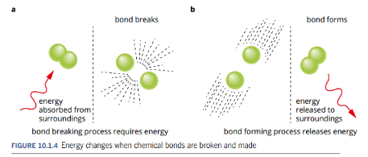
Energy in chemical reactions
Breaking bonds – requires energy Forming bonds – releases energy
Important – weak bonds have more stored chemical potential energy than strong bonds.
This may seem odd, but strong bonds are more stable, the more stable a system is the lower its potential energy.

Slide 9
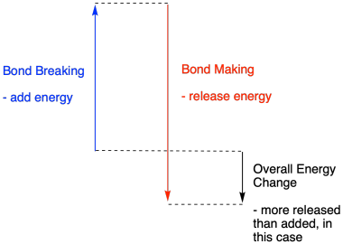
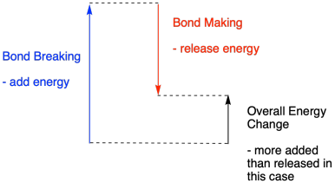
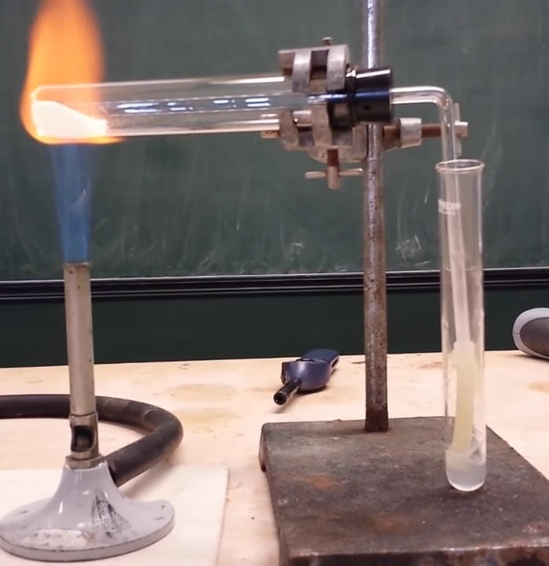
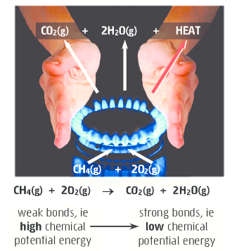



Energy in chemical reactions

Slide 10
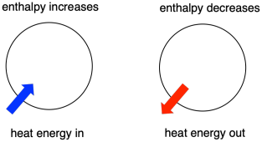
Energy in chemical reactions
The change in chemical potential energy must be balanced by an equal change in other forms of energy, typically in particle kinetic energy (‘heat’)
Result – the temperature of the system changes as heat energy flows into or out of the system to or from the surroundings. Recall, heat energy always flows from hotter to colder regions.
This flow of heat changes the enthalpy (total energy) of the system

Slide 11
Energy in chemical reactions
The change in enthalpy, ΔH, is defined as difference between the enthalpy (H) of the products and reactants:
reactants → products
Calculating enthalpy change (ΔH):
ΔH = H_{products} - H_{reactants}
When the change occurs at constant pressure, in an open flask, the heat gained or lost by the system is equal to the change in enthalpy. In this situation it is called the heat of reaction.

Slide 12
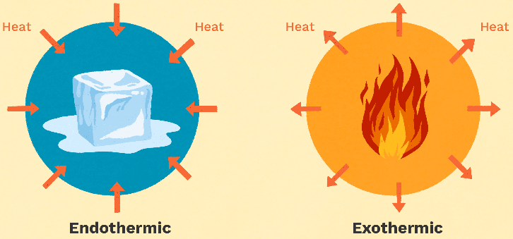
Exothermic and Endothermic
Break down the words to remember their meaning.
Thermic – like thermal, relates to temperature
Exo – like EXIT, energy exits the system
Endo – like ENTER, energy enters the system

Slide 13
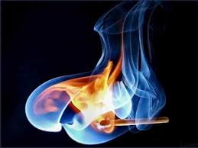


Exothermic and Endothermic
Exothermic reactions
A chemical reaction that releases heat energy to the surroundings is called an exothermic reaction
Total energy of products < Total energy of reactants
Total energy of products is less than the total energy of reactants, so energy is released from the system into the surroundings and the change in enthalpy is negative.
Two ways to represent this:
reactants → products + energy
reactants → products ∆H = -ve kJ
Example:

Slide 14
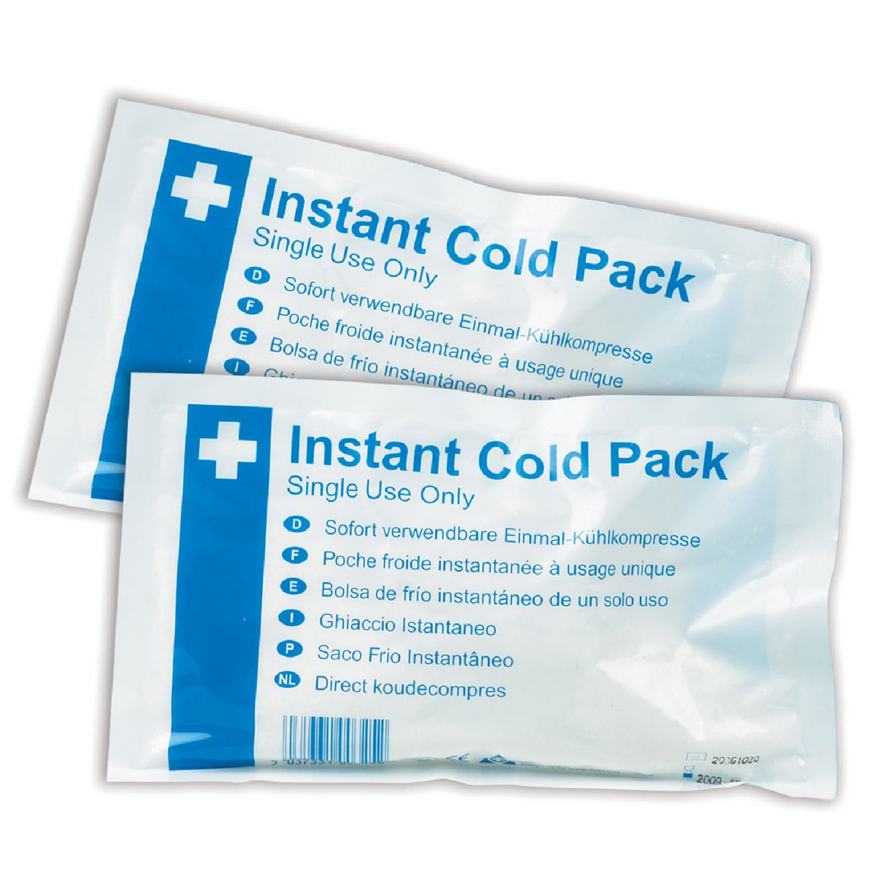

Exothermic and Endothermic
Endothermic reactions
A chemical reaction that absorbs energy from the surroundings is called an endothermic reaction
Total energy of products > Total energy of reactants
Total energy of products is more than the total energy of reactants, so for the reaction to occur it needs to gain energy from the surroundings and the change in enthalpy is positive.
Reactants + energy → products
reactants → products ∆H = +ve kJ
Example:

Slide 15


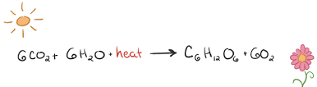

Exothermic and Endothermic
Examples of exothermic and endothermic reactions
exothermic
endothermic
Combustion reaction:
Hydrogen and oxygen to give water:
Neutralisation reactions (acid + base):
Redox reactions (e.g. thermite reaction):
Barium hydroxide plus ammonium chloride
Decomposition of water by electrolysis
Photosynthesis
Energy +
Less stable
More stable
More stable
Less stable
+ heat energy
+ heat energy
+ heat energy

Slide 16
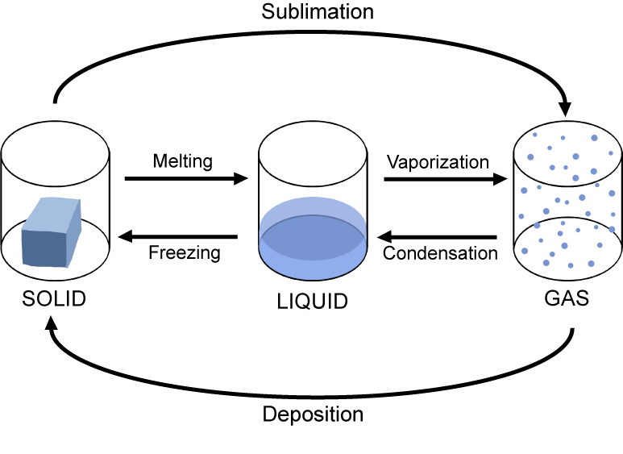
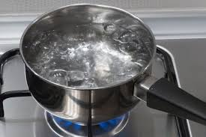
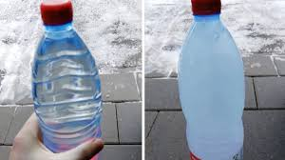
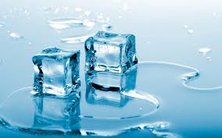

Exothermic and Endothermic
Phase changes also involve changes in the energy of the system
Some processes are exothermic and some endothermic
General
Ordered system, molecules close together – Stable so lower energy
Disordered, molecules spaced out – less stable, higher energy
endothermic
exothermic
Evaporation – liquid to a gas
Freezing – liquid to solid
Watch this ↓
https://www.youtube.com/watch?v=VjEvEyqrrCU&feature=emb_logo
Melting – solid to a liquid
Condensing – gas to liquid

Slide 17
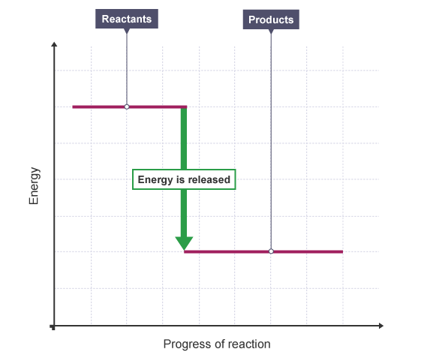
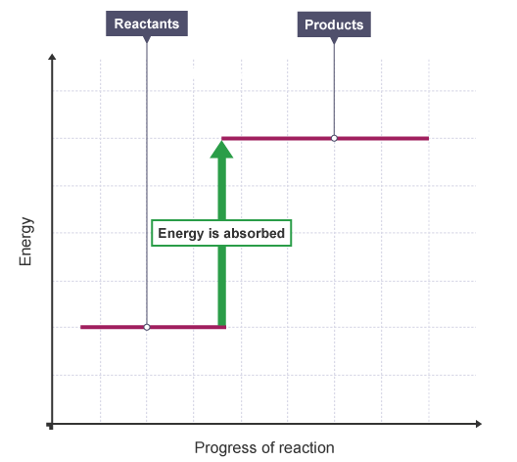
Graphing change in enthalpy
Exothermic
Endothermic
ΔH = H_{products} - H_{reactants}
ΔH = H_{products} - H_{reactants}
ΔH < 0 (negative)
ΔH > 0 (positive)

Slide 18
Graphing change in enthalpy
Energy profile diagrams
H_{reactants}
CH_{4(g)} + 2O_{2(g)}
From this Energy profile diagram you should be able to write the chemical equation with energy included and the thermochemical equation.
Try for yourself
enthalpy
ΔH = -802.4 kJ
H_{products}
CO_{2(g)} + 2H₂O_{(g)}
Progress of reaction
Axis labels: Y-axis is enthalpy, H (sometimes potential energy)
X-axis is progress of reaction (NEVER USE TIME)
Draw line reactants and products – above each write the actual chemicals

Slide 19
Thermochemical equations
From previous slide – you were asked to write:
chemical equation with energy included
thermochemical equation
1.
CH_{4(g)} + 2O_{2(g)}
CO_{2(g)} + 2H₂O_{(g)} + 802.4 kJ
}
exothermic
2.
CH_{4(g)} + 2O_{2(g)}
CO_{2(g)} + 2H₂O_{(g)} ΔH = -802.4 kJ
An endothermic example, formation of nitric oxide:
1.
N_{2(g)} + 2O_{2(g)} + 33 kJ
2NO_{2(g)}
}
endothermic
2.
N_{2(g)} + 2O_{2(g)}
2NO_{2(g)} ΔH = +33 kJ

